Slide 1
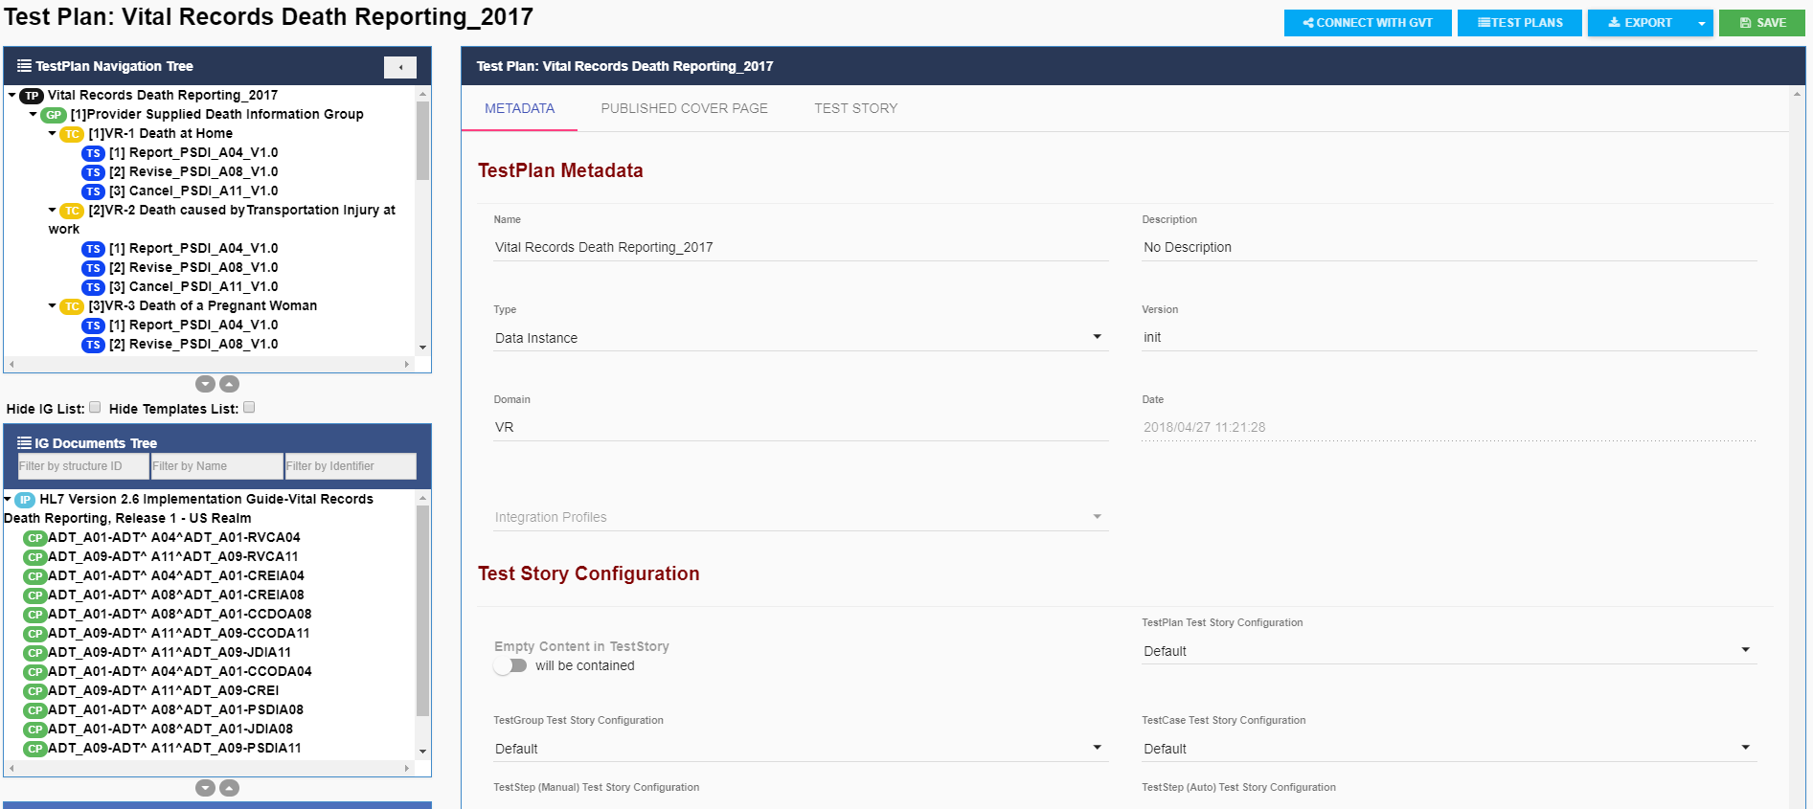
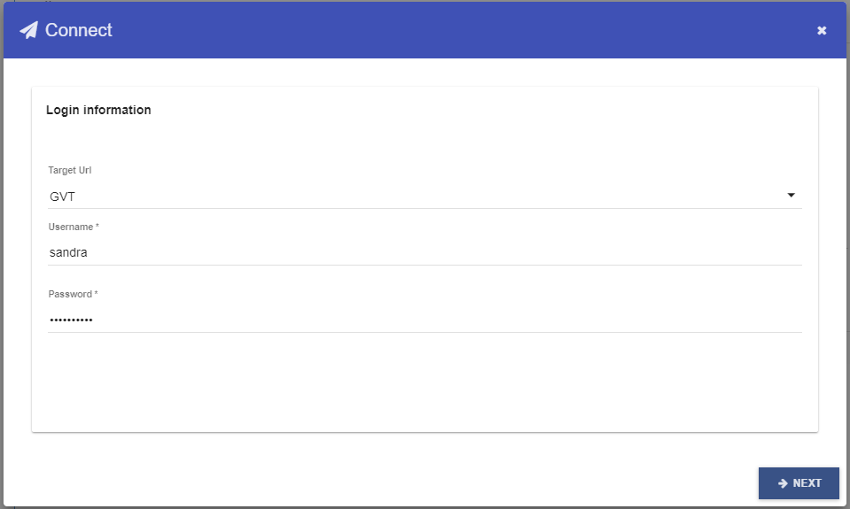
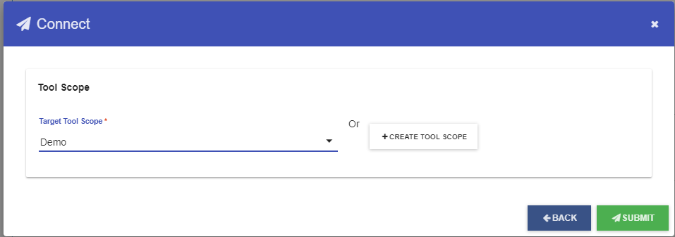
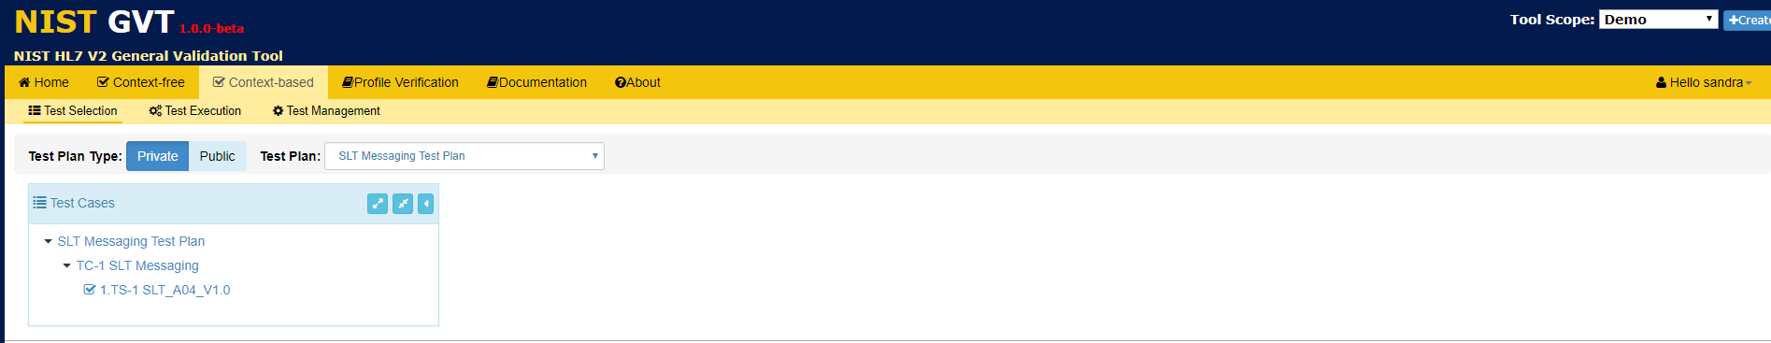
Connecting and Pushing Profiles to GVT from TCAMT
1
In TCAMT, select Test Plans from the main Menu Bar; open a Test Plan, and select Connect with GVT from the Test Plans Menu Bar.
2
Enter GVT Username and Password.
4
Create or Select a Tool Scope
3
Click NEXT
5
Click Submit
The Test plan submitted by TCAMT is displayed under the Context-based Test Selection function in GVT.

